Slide 1
Employee Learning Portal Design Sprint 28Nov -1Dec 2016

Slide 2
There is a clear need for an Employee Learning Portal
The Digital Age Learning Technology workshop in August (University + Group L&D + Group IT) identified a clear need for an Employee learning portal
Existing Learning tools MyLearning
New tools
Content Management system
Work flow system
An Employee Learning portal. A single window of access to all Learning tools, channels, content. Access through multiple devices. Enables by Unified Search capability
Single point of access for learning
Multi device
Social Learning functionality
Driven in the Group IT Innovation zone (or Blue Zone)
Potential to scale up to wider Employee Portal (not in scope at the moment)

Slide 3






We will use the Design Sprint process in this workshop
Set the Stage
Unpack
Sketch
Decide
Prototype
Validate
This will be done over 28th November – 1st December at the Innovation Lab in Suresnes …
Resources:
What is Design Sprint: http://www.gv.com/sprint/
Design Sprint Videos: http://flip.it/sZK.jE

Slide 4
4 clear deliverables from the Design Sprint using digital age learning principles
Workable final design (signed off by key stakeholders)
Prototype of final design (validated with a sample of users)
Clear plan for proof of concept, test and deliver to scale
A mobilised University, Group L&D and Group IT team

Slide 5
Attendees
1. Sarah Otley (NGL Lab Director)
2. Shiva Chattopadhyay (NGL Lab D&I)
3. Shazia Joshi (NGL Lab PM)
4. Debbie Collins (UIS Director)
5. Nilesh Zende (Prototyping)
6. Regis Chasse (Director, Curriculum)
7. Lucile Leclercq (Social expert)
8. Sumegha Lazarus (Ops)
9. Sally Rhodes (Architects SLP experience)
10. Karolin Marakool (User experience)
11. Steven Smith – (in spurts, TBD)
12. Peter Tillegreen
13. Sandrine Humphrey – (in spurts, TBD)
14. Sameer Deshmukh
15. Nada Conan
16. Jan Krogel
17. Bertrand Cauwet (GARI)
18. Anthony Hyvert (CSD)
19. Adrien DEYHIM (DCX)
20. Patrick Stelmaszyk
21. Denis Dupriez
22. Bhaskar Debiswas
23. David Johnson
24. Amit Kumar

Slide 6
Logistics
Venue:
Innovation Lab at Suresnes, Paris (Address: 5/7 Rue Frédéric Clavel, 92150 Suresnes, France)
Timings:
Start time: Monday, 28 November 2016 - 12:00 CET (we start with lunch)
End time: Thursday, 1 December 2016 – 17:00 CET
Hotel: Please book your hotel rooms directly through you travel desk. The nearest/preferred hotel is: Hotel Campanile Paris Ouest - Pont De Suresnes
4 minutes walking distance from the Capgemini Suresnes office.

Slide 7
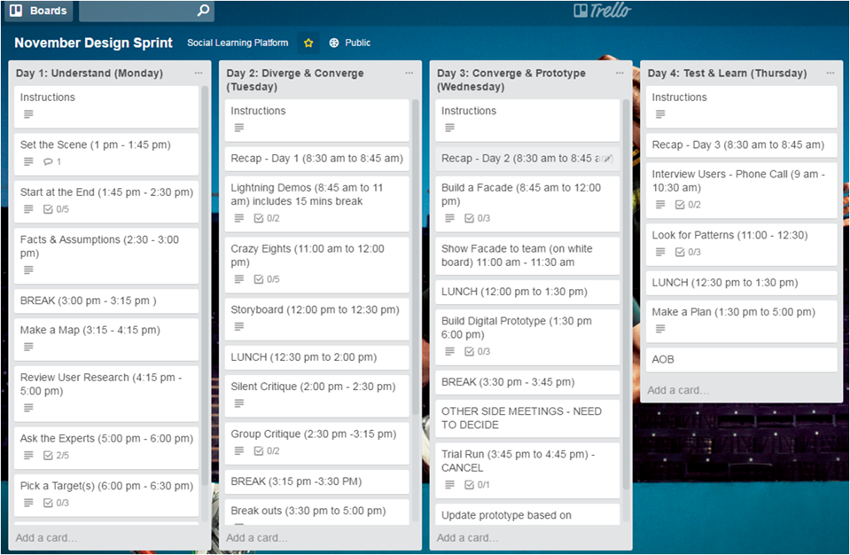

Slide 8
Pre Work 1
Conduct 2 user interviews:
(at least one from global Grade A/B/C)
Take notes: Report back on insights: We are not consolidating the data.
How do you keep yourself current and learn more about your role and the skills you need to continue to develop in your area of work? (this is to set the context and the fact that the focus is learning)
What are your top ‘go-to’ places for learning content: both within the company and outside? (here we are checking sources to which our portal might need to connect to)
How do you access these ‘go-to’ places? (now we are leading them a bit to our main discussion point)
We are planning to design a ‘one shop’ learning portal for Capgemini. What are your hopes for this portal? (a straight question related to the issue at hand)
And what are your fears? (a straight question related to the issue at hand)

Slide 9
Pre Work 2
What alignment do we need to do prior to the session?
What evidence of ideas from elsewhere?
Your notes on great ideas, thoughts, hopes, aspirations …we will work through all that in the 4 days

